Slide 1

The Transparency PUZZLE
Carla Miller, Ethics Director
April 17, 2018

Slide 2

The Pieces…
CPACS (City organized citizen groups)
CARE SYSTEM (complaint system)
PROCUREMENT DATA (State of FL)
HOW THE LEGISLATIVE PROCESS WORKS
LAND USE PROCESSES
HANDOUTS TO CITIZENS
SURVEYS

Slide 3

So much info, so little time…

Slide 4

CURATION
What information is important?

Slide 5


Slide 6

What do the pieces add up to?

Slide 7

OPEN/ INCLUSIVE GOVERNMENT
MOVEMENT

Slide 8
#1
Engaging Citizens: Participatory Budgeting and the Inclusive Governance Movement within the United States
H. Gilman, January 2016

Slide 9
Others are working on it..
“Open Government Partnership” 66 countries
UNDP: SDGs (Sustainable Development Goals) and National Action Plans
Major Cities in the U.S., including Jacksonville
Universities (UNF)

Slide 10
Importance:
It is not just implementing several new programs….
It is a cultural shift involving governments redefining how they interact with citizens

Slide 11
New York--example
Participatory Budget
Cities doing this: double each year
Could be HUD funding for it

Slide 12
Key Idea:
Objective is to not just give citizens more information, but to “create structures that make the exercise of democracy possible”. (Ash report)
Give citizens the opportunity for civic involvement—not just pamphlets and websites to read.

Slide 13
Contrast N.Y.C. with
State of Florida site

Slide 14

Jacksonville

Slide 15
Projects:
Citizen Information (handouts, courses)
Participatory Budgets (Mayor Brown)
CARE system (“Citizens Connect” model)
Florida Sunshine—tons of info on the website
Polls (JEA)
Town Halls
CPACs

Slide 16


Slide 17
SOME PROBLEMS…
SPORADIC SUCCESSES
NO LONG TERM PLAN
LACK OF UTILIZING NATIONAL AND INTERNATIONAL RESOURCES
REINVENTING THE WHEEL

Slide 18
So, what to do?

Slide 19


Slide 20
Some ideas
Establish a permanent Transparency Committee and/or office for the City (a home for continuity)
What city resources (people, existing programs) can assist? List what is being done now.
Identify the national and international resources that have done work in the area.

Slide 21
Citizen Manual
Make suggestions as to how to assemble information we do have so it is more “user friendly”
CITIZEN MANUAL:
How an Idea becomes a Law.
Zoning Issues.
Budget Basics.

Slide 22
City Website
Citizen Portal
Calendar
Blogs
Emails to Officials
Courses
“How-To” info (contract process; budget; zoning)
How to complain/report issue

Slide 23
CPACS
INTERVIEW CPAC CHAIRS
HOW CAN WE EMPOWER OUR EXISTING CITIZEN GROUPS? What do they need?

Slide 24
Key:
Culture Shift
Changing Government processes to bring people together in new ways; not just to overwhelm them with data

Slide 25
Why bother?
Our faith in democracy is fading
Our trust in government is the lowest ever

Slide 26
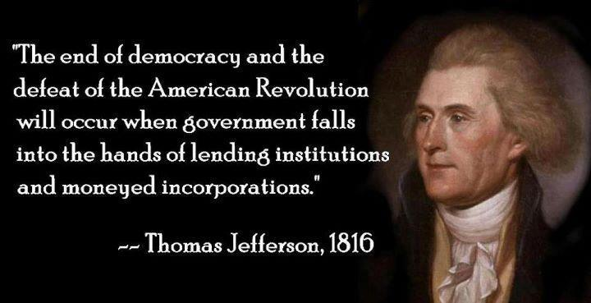

Slide 27

An enlightened citizenry is indispensable for the proper functioning of a republic. Self-government is not possible unless the citizens are educated sufficiently to enable them to exercise oversight.

